Slide 1
NHS Modification in Collier County

Slide 2
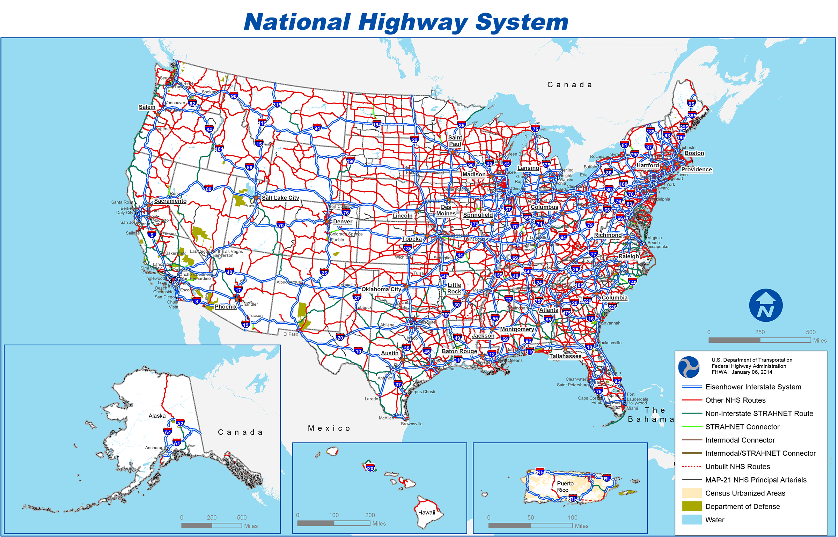
What is the National Highway System (NHS)?
According to Section 470.107 – Federal-aid highway systems:
The National Highway System shall consist of interconnected urban and rural arterials and highways (including toll facilities) which serve major population centers, international border crossings, ports, airports, public transportation facilities, other intermodal facilities, and other major travel destinations; meet national defense requirements; and serve interstate and regional travel. All routes on the Interstate System are part of the National Highway System.
In addition, States can propose modifications to the National Highway System (NHS) and authorizes the Secretary of the U.S. Department of Transportation (DOT) to approve such modifications provided they meet the criteria established for the NHS and enhance the characteristics of the NHS.

Slide 3
Proposed NHS Changes
Roadway Name | From | To | Current NHS Designation | Requested NHS Designation
North Road | Terminal Drive | Airport Pulling Road | NHS IC | None
Airport Pulling Road | North Road | Pine Ridge Road | NHS IC | None
Pine Ridge Road | Airport Pulling Road | I-75 | NHS IC | None
SR 82 | Hendry/Collier County Line | SR 29 | None | NHS PA
IC = Intermodal Connector PA = Principal Arterial

Slide 4
Proposed NHS De-Designation
The Naples Airport does not meet the FHWA’s 250,000 annual enplanements criteria for major intermodal facility.
APF Total Enplanements
Year | Enplanements | Meets NHS Criteria?
2013 | 2,333 | No
2014 | 874 | No
2015 | 110 | No
2016 | 1,337 | No
2017 | 505 | No
2018 | 2,212 | No

Slide 5
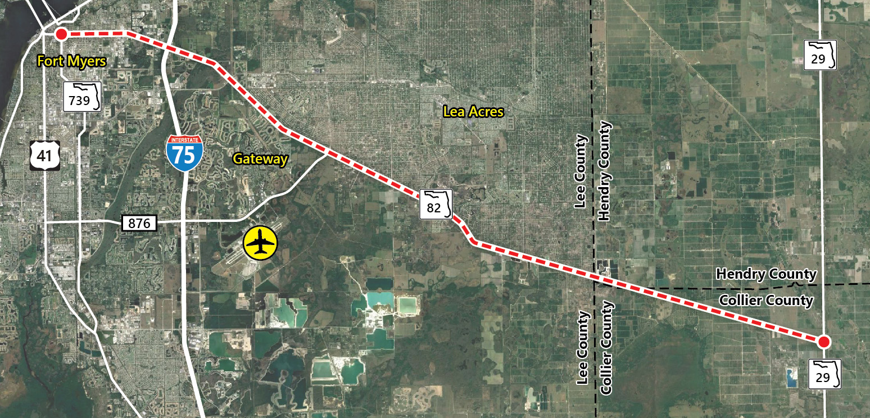
Proposed NHS Addition
SR 82 between SR 739 (USB 41) in Lee County to SR 29 in Collier County is proposed for NHS Principal Arterial designation.* SR 82 serves as a major freight transportation route, connecting Lee, Hendry and Collier Counties.
Programmed Improvements
Roadway ID | Roadway Name | Work Summary | Current Phase | Programmed Lanes
430848-1 | Hendry C/L to Gator Slough Lane | Add Lanes and Reconstruct | Construction (FY 2023) | 4
430849-1 | Gator Slough Lane to SR 29 | Add Lanes and Reconstruct | Construction (FY 2020) | 4
* SR 82 between I-75 in Lee County and SR 29 in Collier County is designated as a SIS Highway corridor.
Programmed Improvements

Slide 6
Action Requested | Approval of the Modification to the NHS.
Your approval will:
Assist FDOT in their recommendation to FHWA.
Enhance the NHS network connectivity within Collier County and the region.

