Slide 1

2020 ANNUAL REPORT
December 11, 2020

Slide 2
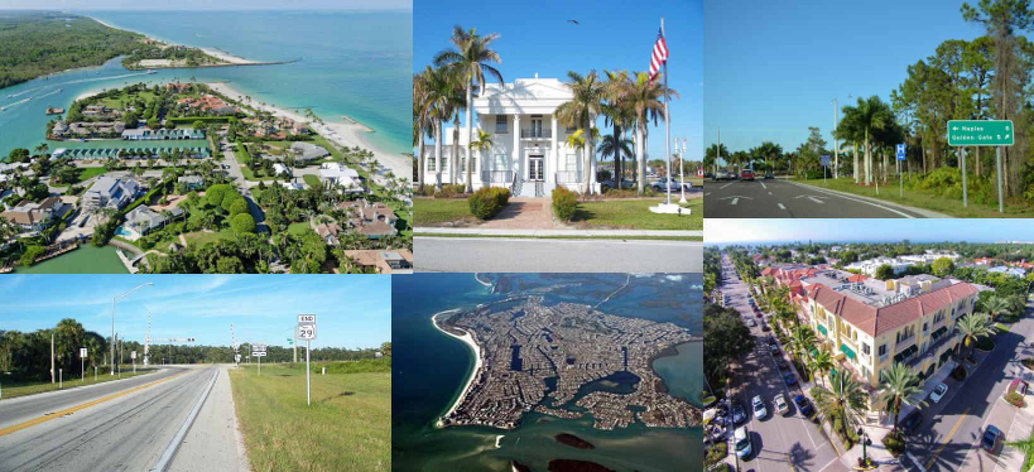
Mission: to provide transportation planning leadership through a collaborative effort to maintain a safe, efficient, integrated and multi-modal transportation system.

Slide 3
STRIVE TO PROVIDE A FULLY INTEGRATTED AND MULTIMODAL TRANSPORTATION SYSTEM THAT SAFELY AND EFFICIENTLY MOVES PEOPLE AND GOODS WHILE PROMOTING ECONIMIC DEVELOPMENT AND PROTECTING NATURAL AND MAN-MADE REGIONAL ASSETS.
VISION

Slide 4
OVERVIEW
Report on federal Transportation Performance Measures and Board-adopted measures in the 2020 Strategic Plan, Bicycle and Pedestrian Master Plan (2019) and Congestion Management Process (2017)

Slide 5
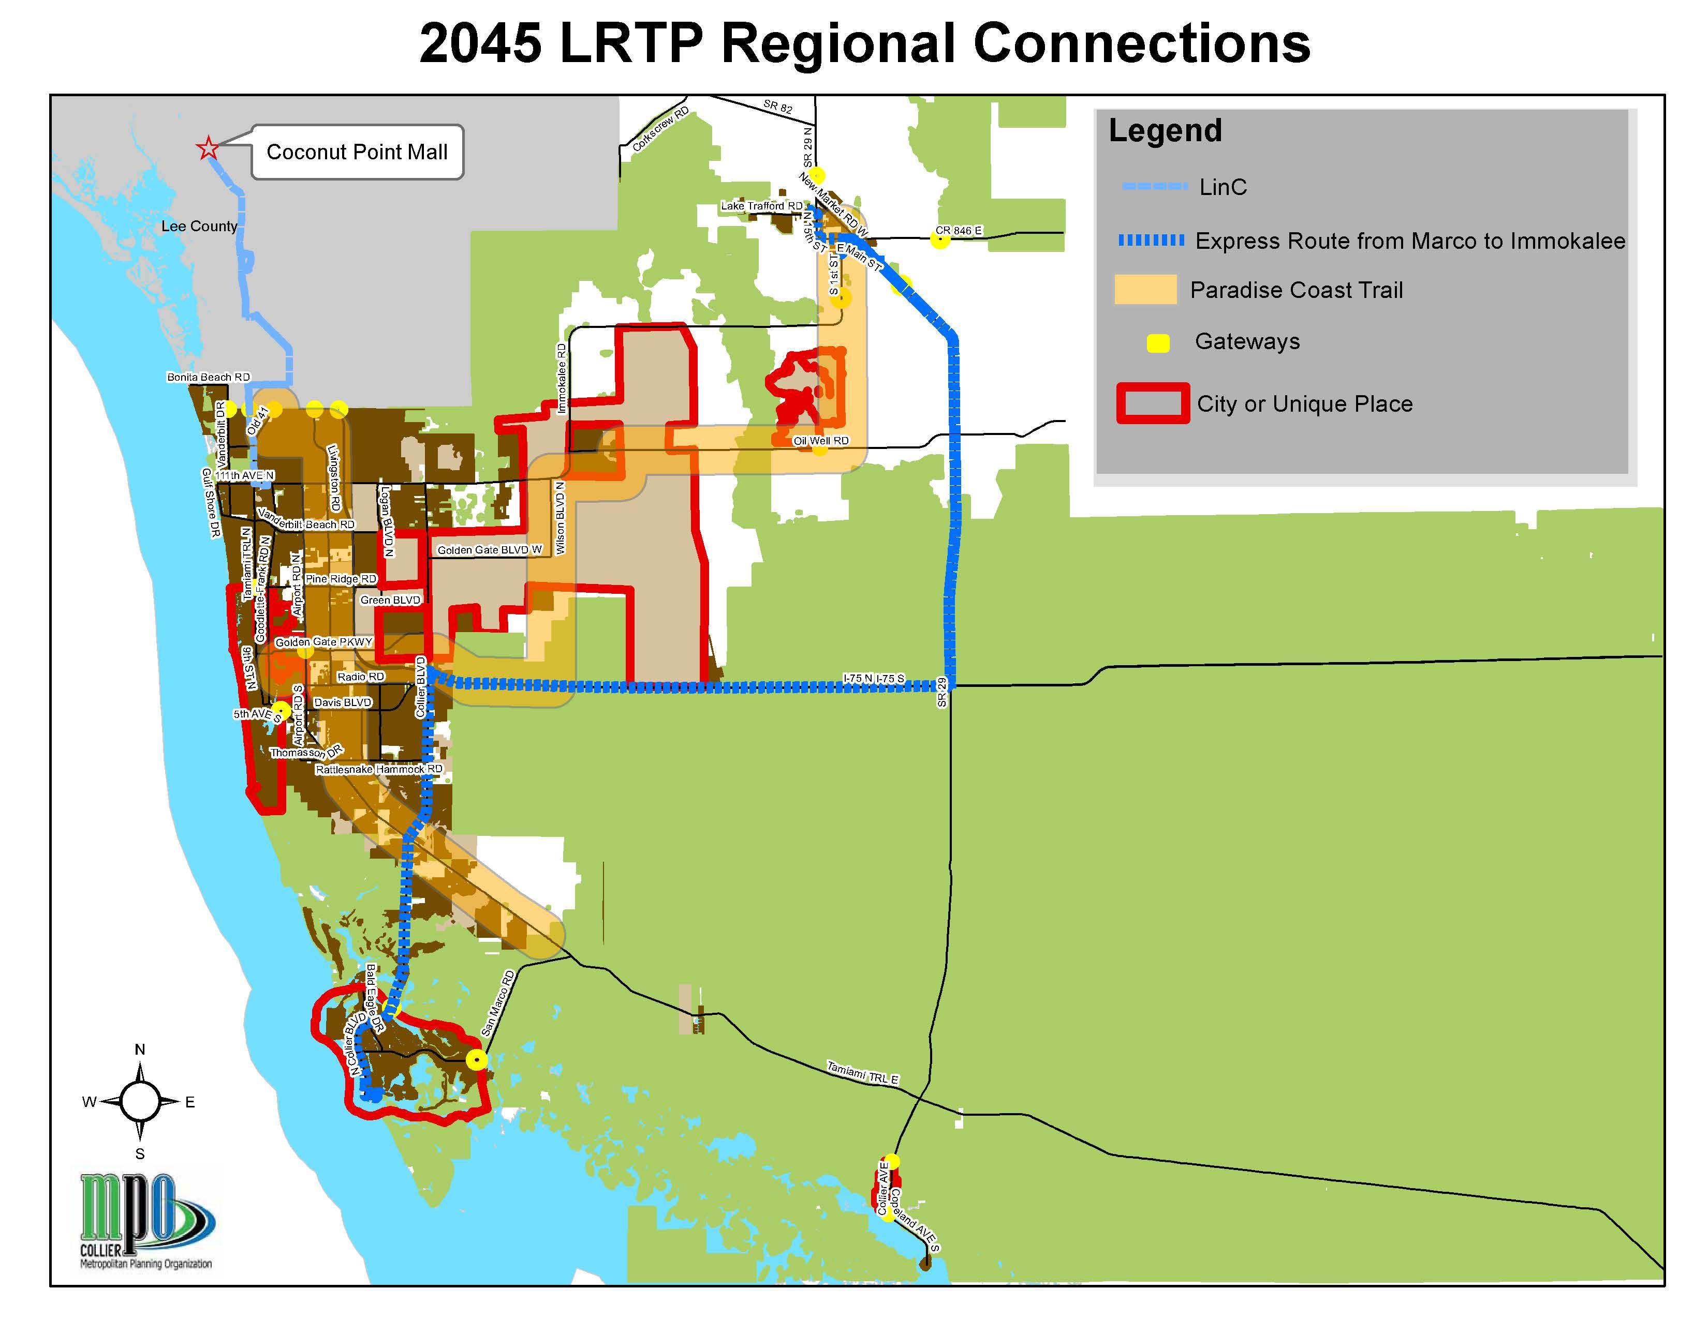
Defining Urban Form Characteristics, Regional Connections
Largest county in Florida by land area
67% in Conservation
Special Places:
-City of Naples
-City of Marco Island
-City of Everglades City
-Immokalee
-Golden Gate City
-Golden Gate Estates

Slide 6
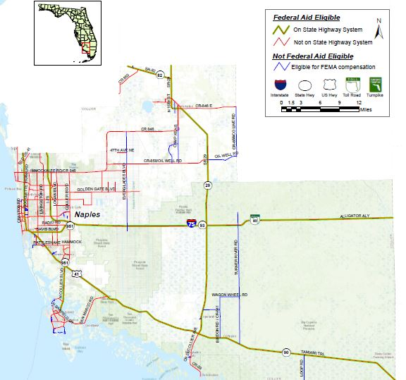
Transportation Infrastructure Characteristics
Limited number of State roads
Urbanized area bisected by I-75
Widely spaced arterials
Few Collector Roads
Major North/South connectors are limited to:
-I-75
-US 41 / SR
-SR 29/SR 82
Geographic dislocation between Work Force Housing and Employment
Seasonal Population Influx
Limited multimodal alternatives available

Slide 7
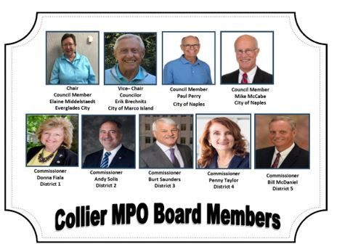
MPO Board

Slide 8
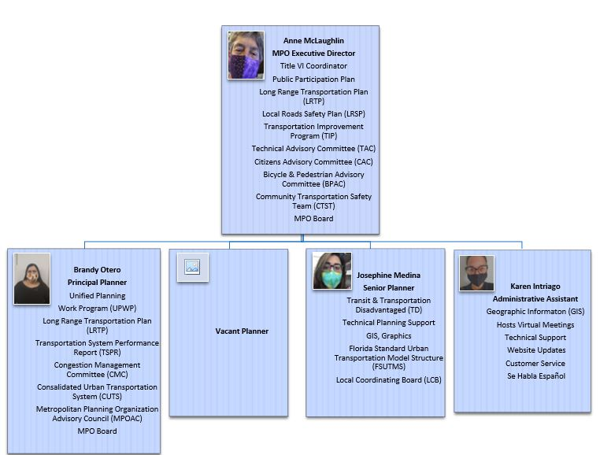
STAFFING

Slide 9
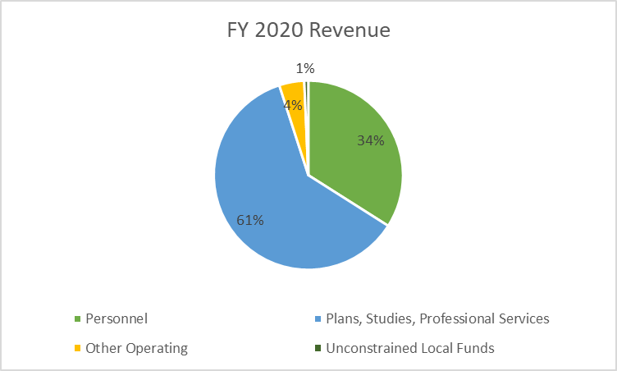
OPERATING BUDGET
FY 2020 UPWP
FY 2020 Revenue | Amount | %
Plans, Studies, Professional Services | $392,100 | 61%
Personnel | $703,700 | 34%
Other Operating | $49,500 | 4%
Unconstrained Local Funds | $8,000 | 1%
 | $1,153,300 | 100%

Slide 10
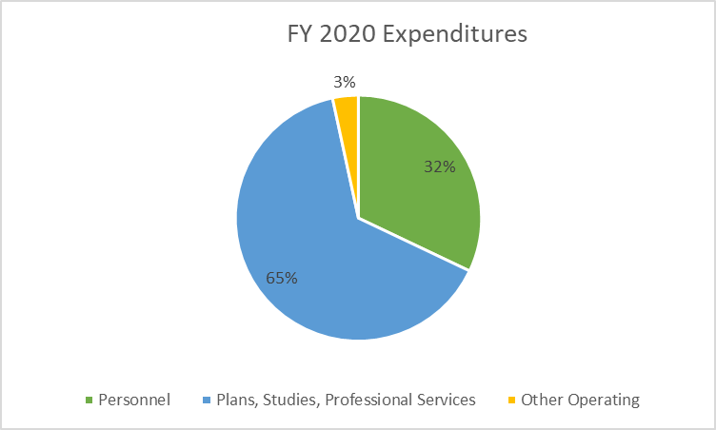
EXPENDITURES
FY 2020
FY 2020 Expenditures | Amount | %
Plans, Studies, Professional Services | $984,700 | 65%
Personnel | $489,300 | 32%
Other Operating | $51,700 | 3%
 | $1,525,700 | 100%

Slide 11
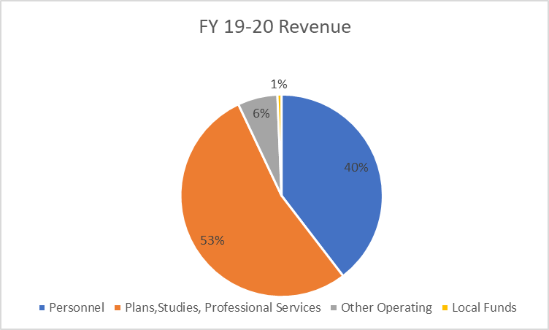
TWO-YEAR OPERATING BUDGET
FY 19-20 Revenue
FY 19-20 Revenue | Amount | %
Plans, Studies, Professional Services | $1,283,600 | 53%
Personnel | $952,300 | 40%
Other Operating | $153,300 | 6%
Unconstrained Local Funds | $16,000 | 1%
 | $2,405,200 | 100%

Slide 12
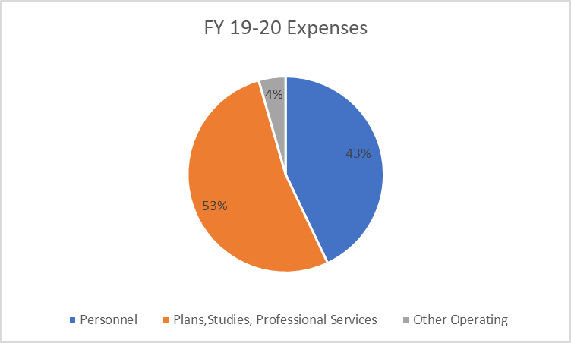
TWO-YEAR EXPENDITURES
FY 19-20
FY 19-20 Expenditures | Amount | %
Plans, Studies, Professional Services | $1,057,200 | 53%
Personnel | $863,500 | 43%
Other Operating | $89,300 | 4%
 | $2,010,000 | 100%

Slide 13
SUMMARY
FY 19-20
FY 19-20 Overview | Amount
Revenue | $2,405,200
Expenditures | $2,010,000
Balance as of July 1 | $395,200
Closeout Balance from PL Grant | $82,700
Remaining balance has been invoiced or is committed to pay for transit studies completed by 12/31 | $312,500
New 2-Year UPWP Budget Started July 1, 2020 - $1,743,858
Notes:
In the past, the MPO has strategically saved to cover costs of the Long Range Transportation Plan every 5 years. The LRTP has become more expensive with each plan and cost $600,000 for the last contract. The MPO is allowed to allocate SU funds to planning projects, but not if the MPO carries more than a 20% balance.
80/20 Work Program Rule:
Per Chapter 22, Section A.3.c.1. of the FDOT Work Program Instructions: If the PL carryforward balance plus de-obligations at the end of the UPWP cycle exceeds 20% of an MPO’s PL approved allocations for the 2-year UPWP cycle, then State Transportation Block Grant (STBG) funds will not be authorized on the new UPWP until the MPO is in compliance with this policy.
FDOT has consistently requested that MPOs spend down their PL balance to avoid fiscal constraint . This MPO has made an effort to spend down our funding in order to allow us to prioritize the LRTP as a planning project.
*MPOs that carry a balance may be subject to a rescission during an economic downturn.

Slide 14
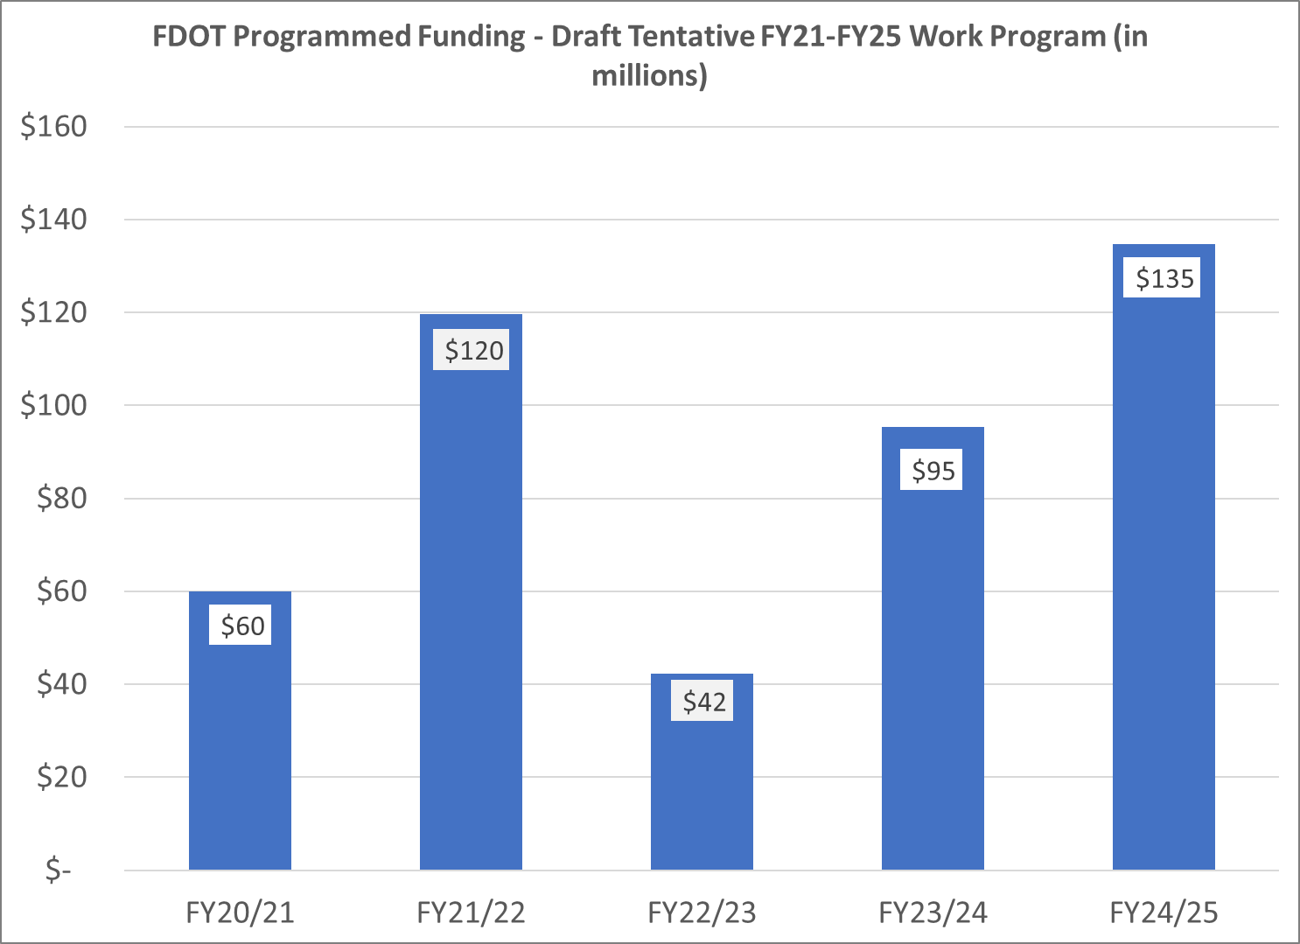
TRANSPORTATION IMPROVEMENT PROGRAM
FY 2021- 2025

Slide 15
TRANSPORTATION IMPROVEMENT PROGRAM
FY 2021- 2025

Slide 16
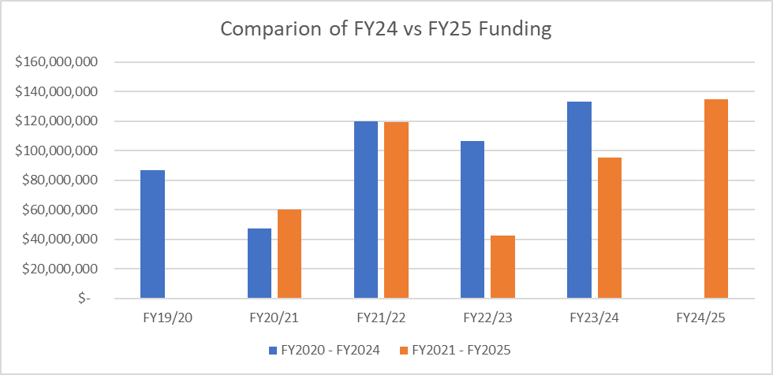
VARIATIONS IN
TIP FUNDING
AT A GLANCE
FY 2020-2024
FY 2021- 2025

Slide 17
MPO Measures
Established locally through adopted/approved plans

Slide 18
2020 STRATEGIC PLAN
GOALS
PROACTIVE REGIONAL COLLABORATION
IMPROVED PUBLIC OUTREACH
ACCURATE & TIMELY DATA GATHERING, ANALYSIS & REPORTING

Slide 19
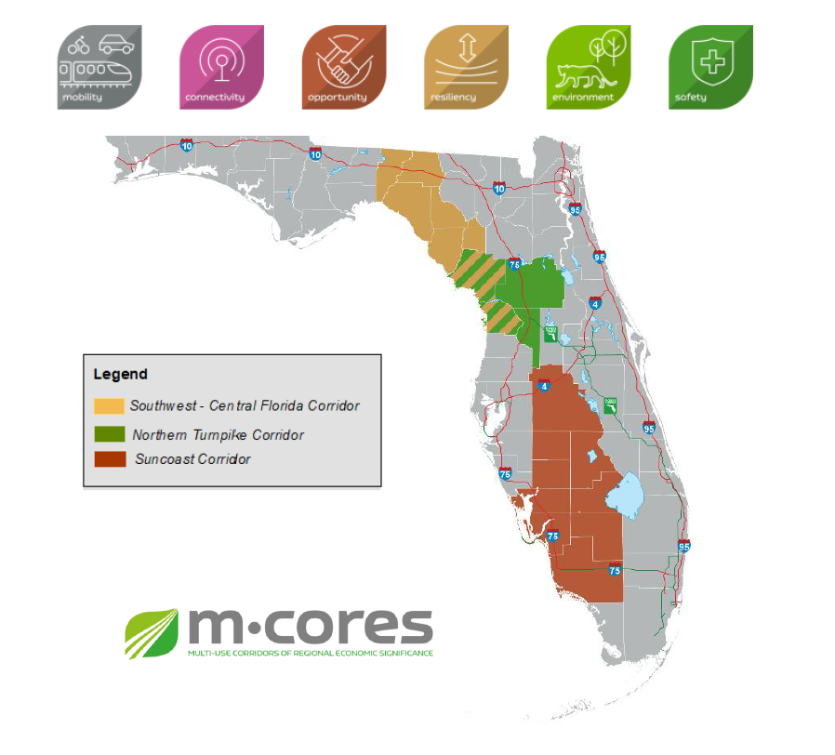
REGIONAL COLLABORATION:
M-CORES
ACUNE
TRIP Updated June 2020
2045 LRTPs (including Transit)
TAC meetings
MPOAC meetings
CUTS meetings

Slide 20
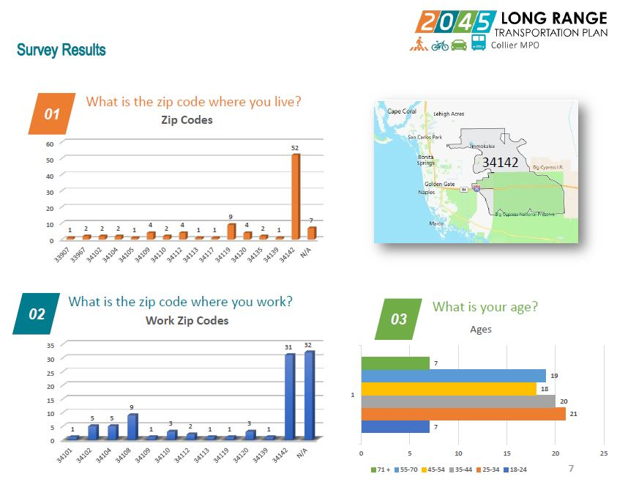
PUBLIC OUTREACH
The Adviser Network grew from 52 members in 2019 to 467 in 2020
Over 5,000 Survey Responses were received (TSPR, LRSP, TDP, LRTP)
ZIP Code Tracking Shows Broad Geographic Distribution of Respondents, and
Broad Age Distribution
Advisory Committees found it easier to achieve quorums when virtual meetings were allowed under Executive Orders of the Governor

Slide 21
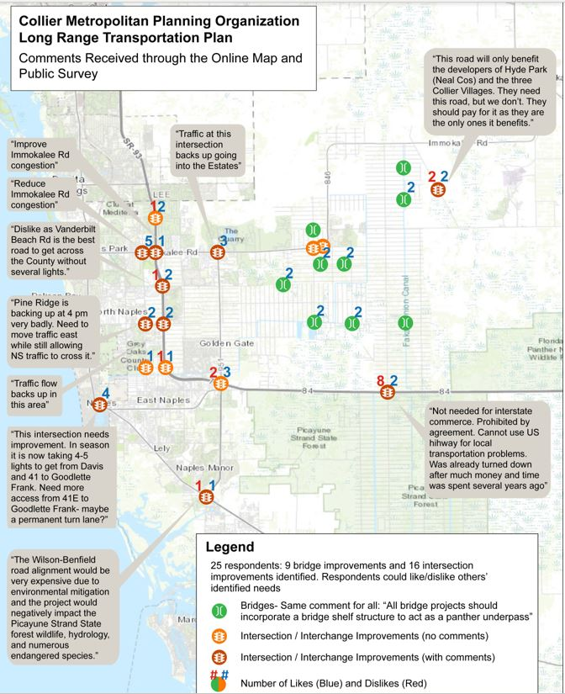
Wikimap & On-line Survey Comments 2045 LRTP

Slide 22
DATA ANAYLSIS & REPORTING
Staff training & professional development
  Florida Standard Urban Transportation Modeling System (FSUTMS) Model Advancement Committee, Workshops, Webinars
  D1 RTDM, VISSIM/VISUM Training
  FTA’s Data Sharing in Transit/Shared Mobility Partnership Webinar
  National Transit Institute’s (NTI) State and Metro Transportation Programming Course
  NTI’s Transit Oriented Development Course
  Association of Metropolitan Planning Organization (AMPO) GIS webinar

Slide 23
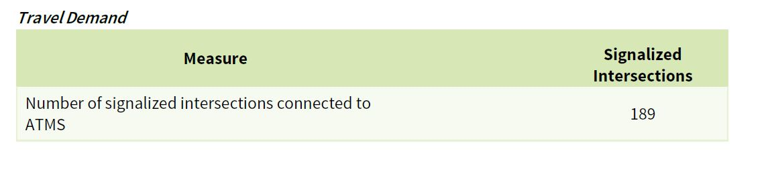
Congestion Management Process 2017
ITS Measures
There were no RITSA concurrency projects programmed in FY20 of the TIP, and
No projects to connect additional intersections to ITS; however,
the Transportation System Performance Report (TSPR) Baseline Conditions (2020) established this measure:
Maintain Concurrency with FDOT Regional ITS Architecture (RITSA)
Increase number signalized intersections connected to ITS
Improved Travel Time Reliability (See Mobility Measures on 2 following slides)

Slide 24
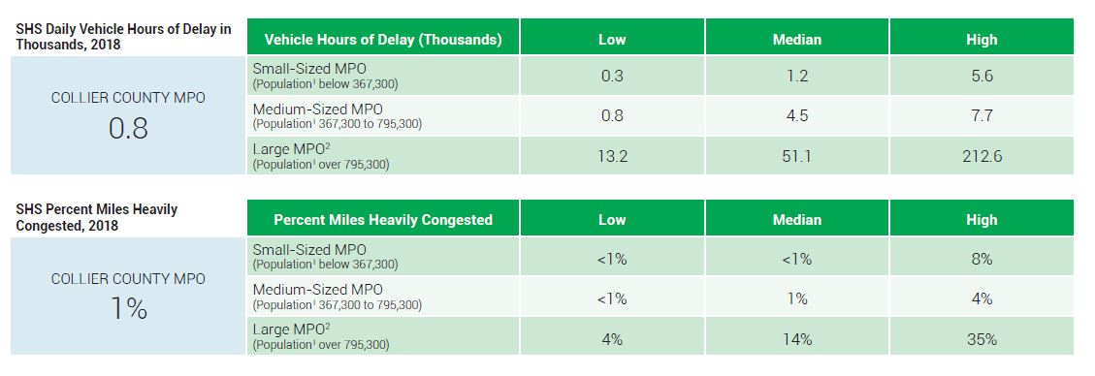
Mobility Measures 2018 Data Reported 12-3-20 by FDOT

Slide 25
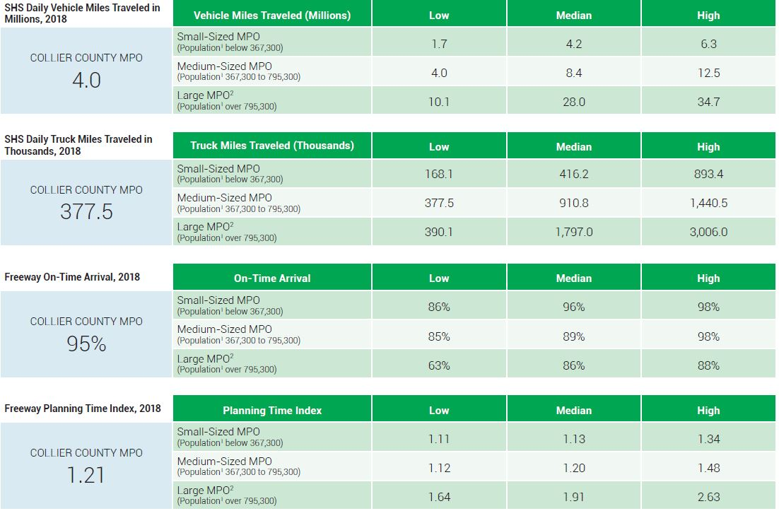
Mobility Measures 2018 Data Reported 12-3-20 by FDOT

Slide 26
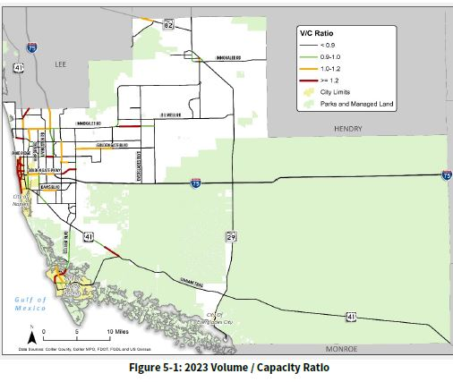
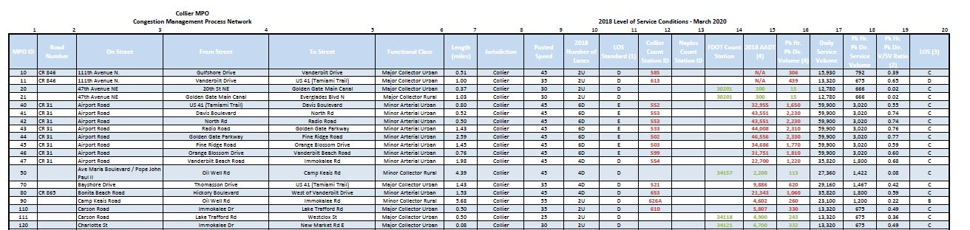
Congestion Management Process 2017
Capacity Enhancement Measures
TSPR ESTABLISHED BASELINE (BENCHMARK) CONDITIONS FOR LOS, also V/C Ratios and Travel Time/Speed Based Results
Identify benchmark Level of Service (LOS)
Establish post-construction LOS

Slide 27
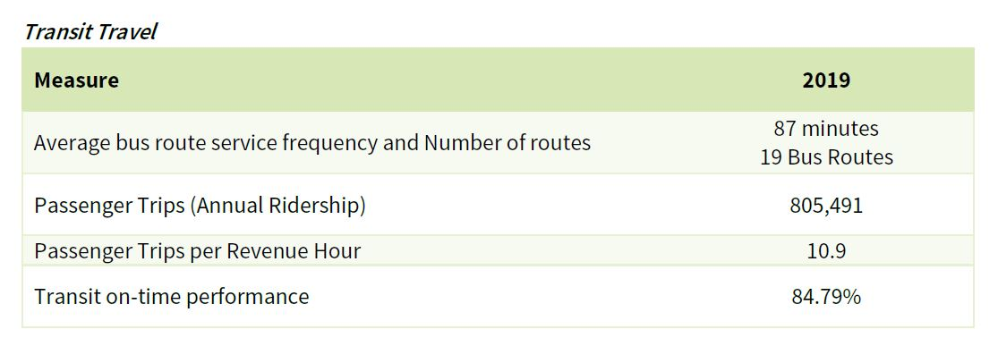
Congestion Management Process 2017 &
TSPR Baseline Report Measures for TRANSIT
Increased ridership existing routes before/after installation of bus shelters
Increased number of riders at specific transit stops before/after installation of bus shelters
ADA and other improvements connecting bike/ped network to bus stops
CMP 2017 Measures
TSPR – Baseline Conditions

Slide 28
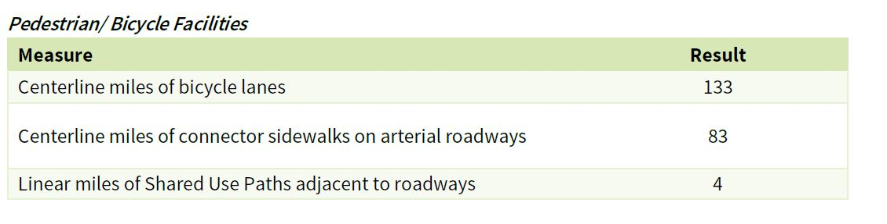
Congestion Management Process 2017, Bike-Ped Master Plan (BPMP) 2019 & TSPR 2020
Nonmotorized Measures
Reduction in miles of gaps in cycling network identified in BPMP
Address problem areas identified in BPMP through Community Walkability Studies, Bike/Ped Safety Audits, Safety Studies
CMP 2017 – Performance Measures
TSPR – Established Baseline Conditions for BPMP performance measures
BPMP also calls for an annual status report on B/P Project Priorities: newly programmed projects will first appear in 2022-2026 Work Program & 2021 Annual Report

Slide 29
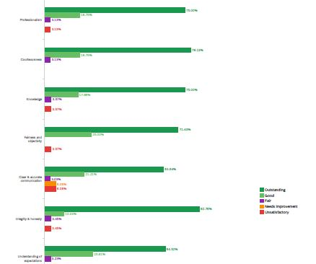
Congestion Management Process 2017
Customer Service
Annual survey conducted by County Traffic Operations

Slide 30
National Measures

Slide 31
 | TRANSPORTATION PERFORMANCE MEASURES & TARGETS - COLLIER MPO ANNUAL REPORT DECEMBER 2020
 | Measure | Target | 2019 Conditions | Meets
PAVEMENT | NHS Interstate Pavements | ≥ 60% Good in 4yrs | 69.00% | Yes
 |  | ≤ 5% Poor in 4yrs | 0% | Yes
 | NHS Non-Interstate Pavements | ≥ 40% Good in 2&4yrs | 39.40% | No
 |  | ≤ 5% Poor in 2&4yrs | 0% | Yes
BRIDGE | NHS Bridge Deck Area Condition | ≥ 50% Good in 2&4yrs | 78.00% | Yes
 |  | ≤10% Poor in 2&4yrs | 1% | Yes
SYSTEM PERFORMANCE | % NHS Interstate Person-Miles Traveled That Are Reliable | 75% in 2yrs, 70% in 4yrs | 100% | Yes
 | % NHS Non-Interstate Person-Miles Traveled That Are Reliable | n/a in 2yrs, 50% in 4yrs | 99% | Yes
 | Truck Travel Time Reliability Ratio on NHS Interstate | ≤1.75 in 2yrs, 2.0 in 4yrs | 1.16 | Yes
TRANSIT | Transit Rolling Stock | ≤10% have met or exceeded ULB | 0% | Yes
 | Transit Equipment | ≤25% have met or exceeded ULB | 0% | Yes
 | Transit Facilities | ≥25% < 3 TERM | 25% | Yes
SAFETY** | Fatalities | 0 | Pending | No
 | Serious Injuries | 0 | Pending | No
 | Fatality Rate per Annual 100 MVMT | 0 | Pending | No
 | Injury Rate per Annual 100 MVMT | 0 | Pending | No
 | Nonmotorized Fatalities & Serious Injuries | 0 | Pending | No

Slide 32
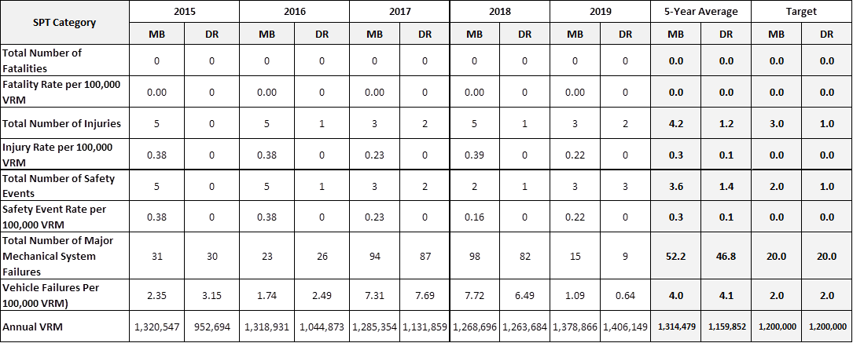
Transit Safety Targets adopted by MPO Board in 2020

Slide 33
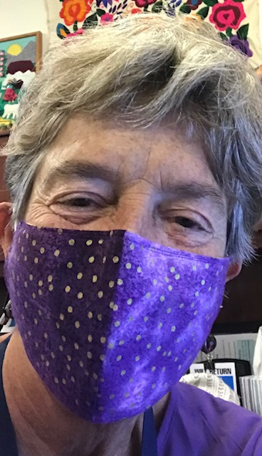
2020
COVID-19
On-line public outreach & engagement, virtual meetings, 6 major plans underway & Federal
Certification Review
Still met deadlines
2021
COVID-19 accelerated an era of continuous change in human behavior, on top of climate change, technological, social & economic change
Anne.McLaughlin@colliercountyfl.gov
Director’s Summary

Slide 34
https://www.colliermpo.org/
239-252-5814

