Slide 1
Local Road Safety Plan Draft Findings
September 28, 2020

Slide 2
Presentation Overview
What is the Collier County Local Road Safety Plan (LRSP)
Data Analysis and Findings
Recommendations
Next Steps

Slide 3
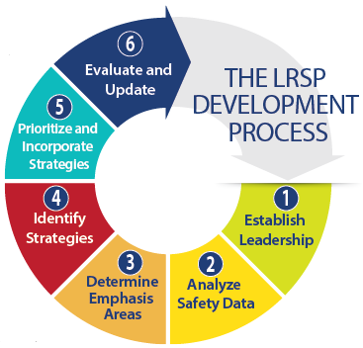
LRSP Overview
Process recommended by FHWA as “Proven Safety Countermeasure”
Data Driven
Multi-Disciplinary

Slide 4
Countywide Crash Data Analysis
VMT Distribution of Collier County and Florida by Functional Class
Collier County relies more on signalized arterial and major collector roadways than the state as a whole.
Generally these roadways have worse safety outcomes than limited access highways and lower speed minor collector and local streets.
Roadway Functional Classification | Florida |  | Collier |  | Crash Characteristics
Interstate, Turnpike & Freeways | 26% |  | 21% |  | Limited Access, Low Crashes/VMT
Other Principle Arterials | 25% | 50% | 16% | 59% | Higher Speed, More Conflict Points
Minor Arterials | 15% |  | 29%
Major Collectors | 11% |  | 14%
Minor Collectors | 2% | 23% | 2% | 20% | Lower Speed, Less Severe Crashes
Locals | 21% |  | 18%

Slide 5
Data Analysis
 | Florida | Collier County | Collier County vs. Florida
Crashes/100k Pop. | 1,904 | 1,413 | 74%
Fatalities/100k Pop. | 15 | 11 | 73%
Injuries/100k Pop. | 1,204 | 806 | 67%
Overall, Collier County performs better than the State of Florida

Slide 6
Data Analysis: Major Roadway Focus
Excluding I-75, arterial and collector roads account for:
74% of severe crashes
77% of all reported public roadway crashes
All Crashes
Severe Crashes

Slide 7
Data Analysis: Maintenance Authority
Crash Distribution by Major Roadway Maintenance Authority:
County-maintained roads account for 62% of severe crashes and 72% of all crashes.
Crash distribution is roughly proportional to vehicle miles traveled for each maintenance authority.
All Crashes
Severe Crashes
Vehicle Miles Travelled

Slide 8
Data Analysis: Crash Types
47.3%
Crash Type Distribution:
Rear end crashes are the most common overall crash type.
Several crash types have out-sized severity ratios compared with overall frequency.

Slide 9
Data Analysis
 | High Severity Ratio | Low Severity Ratio
High Severity Frequency (> 5% of All Severe Crashes) | Bike Pedestrian Left-Turn Angle Hit Fixed Object | Rear-End Unknown/Other
Low Severity Frequency (<5% of All Severe Crashes) | Head-On Single Vehicle U-Turn Run Off Road | Sideswipe Right-Turn Hit Non-Fixed Object

Slide 10
Data Analysis: Age
At Fault Driver Age:
Younger and middle-aged adults are over-represented in reported crashes.
Older drivers may have less exposure (fewer miles travelled).

Slide 11
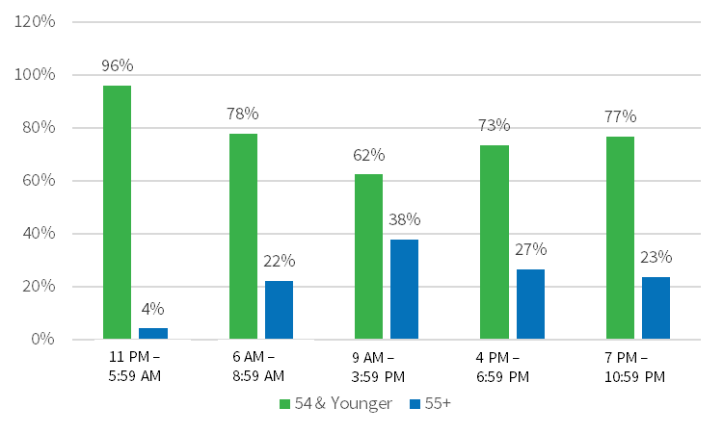
Data Analysis: Age
70%
30%

Slide 12
Data Analysis: Annual Trends
Annual Trend:
Crashes trending upward year-over-year, but trend is unstable.
Trend

Slide 13
Data Analysis: Seasonal Distribution
Average Crashes per Month:
Average of 702 reported crashes per month.
Monthly trends generally follow overall seasonal patterns.
Average

Slide 14
Data Analysis: Citations
Most Common Moving Violations:
Exceeding posted speed most common citation
Disregard traffic control or traffic signal are second most common

Slide 15
Data Analysis: Citations
Traffic Citation Data:
Collier County issues fewer citations than the state average per capita and per vehicle miles travelled.
FHP and Collier Sheriff issue the bulk of traffic citations.
State and County | Violations (2014-18) | Total VMT (2014-18) | Citations per 100K VMT | Population | Citations per 100K Pop.
Florida | 1,978,741 | 582,491,060 | 340 | 20,159,183 | 9,816
Collier | 22,136 | 9,939,709 | 223 | 351,121 | 6,304
Brevard | 29,592 | 17,784,554 | 166 | 568,367 | 5,206
Escambia | 24,176 | 9,657,445 | 250 | 310,556 | 7,785
Lee | 83,614 | 20,667,894 | 405 | 682,448 | 12,252
Manatee | 23,208 | 10,038,803 | 231 | 358,616 | 6,472
Sarasota | 33,880 | 12,052,890 | 281 | 400,694 | 8,455

Slide 16
Data Analysis: Survey
Over 1,000 responses

Slide 17
Data Analysis: Survey
Frequency of Motor Vehicle Use

Slide 18
Data Analysis Survey
Driver Behavior Concerns:

Slide 19
Data Analysis: Survey
I feel safe and comfortable while biking/walking in Collier County…
Biking Walking

Slide 20
Data Analysis: Findings
Collier County has better safety performance than the State.
Most crashes occur along major roadways.
About 2/3 of these occur along County-maintained roads
Older road users do not disproportionately contribute to crashes in Collier County, likely due to reduced exposure
Fewer traffic citations per capita and per vehicle mile of travel are issued in Collier County than average
Non-motorized road user, angle, left-turn, and lane departure crashes account for 30% of all crashes but result in 72% of severe injuries and 89% of fatalities.
Rear-end and sideswipe crashes result in a significant number of incapacitating injuries due to their frequency.

Slide 21
Data Analysis: Emphasis Areas
 | All Crashes | Non-Motorized | Intersection | Lane Departure | Same Direction
Total Crashes | 38,887 | 862 | 6,819 | 3,829 | 23,419
Injury Crashes | 3,469 | 448 | 1,030 | 567 | 1,111
Total Injuries | 4,719 | 470 | 1,621 | 747 | 1,492
Total Serious Injuries | 928 | 136 | 326 | 201 | 187
Fatal Crashes | 148 | 38 | 39 | 53 | 10
Total Fatalities | 160 | 38 | 40 | 64 | 10
Severity Ratio | 2.4% | 15.8% | 4.8% | 5.2% | 0.8%
Percent of All Crashes | NA | 2% | 18% | 10% | 60%
Percent of Severe Injuries | NA | 15% | 35% | 22% | 20%
Percent of Fatalities | NA | 24% | 25% | 40% | 6%

Slide 22
Infrastructure Strategies
Infrastructure Strategies | Non-Motorized | Intersection | Lane Departure | Same Direction
Speed Management | • | • | • | •
Alternative Intersections (ICE Process) | • | • |  | •
Intersection Design Best Practices for Pedestrians | •
Median Restrictions/Access Management |  | • |  | •
Right Turn Lanes | ? |  |  | •
Signal Coordination | ? |  |  | •
Rural Road Strategies including:
Paved shoulder | • |  | •
Safety edge |  |  | •
Curve geometry, delineation, and warning |  |  | •
Bridge/culvert widening/attenuation |  |  | •
Guardrail/ditch regrading/tree clearing |  |  | •
Isolated intersection conspicuity/geometry |  | •
Shared Use Pathways, Sidewalk Improvements | •
Mid-Block Crossings & Median Refuge | •
Intersection Lighting Enhancements | • | • | •
Autonomous Vehicles (Longer-Term) | TBD | • | • | •
? = Possible Contra-indications

Slide 23
Infrastructure: Speed Management
Adopt/Adapt FDOT’s Context Classification System to the County’s major roadways.
Using the classification system, establish target speeds
Prioritize engineering studies to identify design interventions to achieve targets
Consider signal operations (density, progression, & cycle length) as speed management strategies

Slide 24
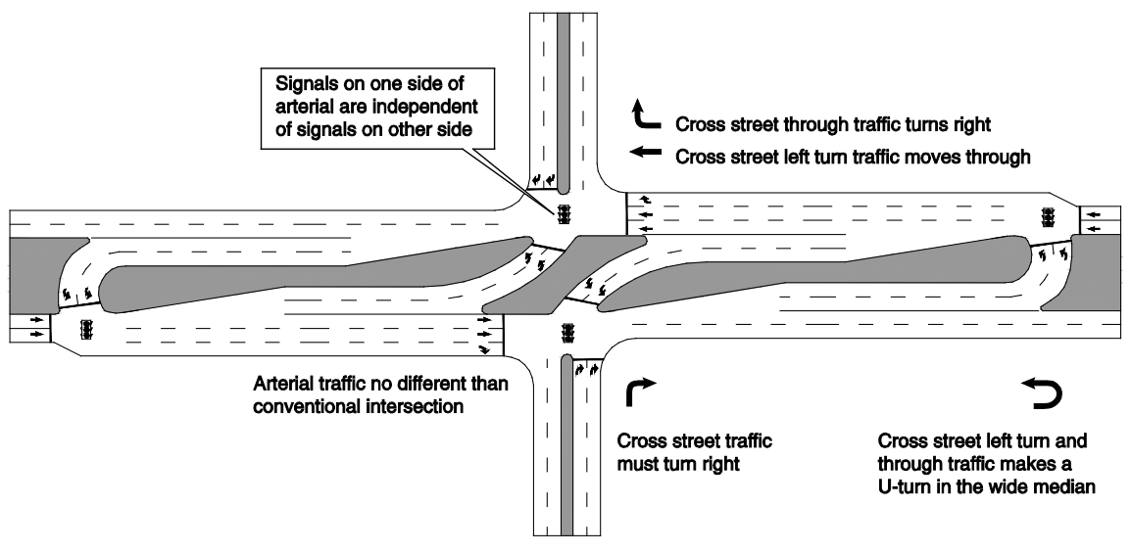
Infrastructure: Alternative Intersections
Adopt/Adapt FDOT’s Intersection Control Evaluation (ICE) process
Identify candidate intersections
Conduct “Stage 1” analysis to screen and prioritize candidates

Slide 25
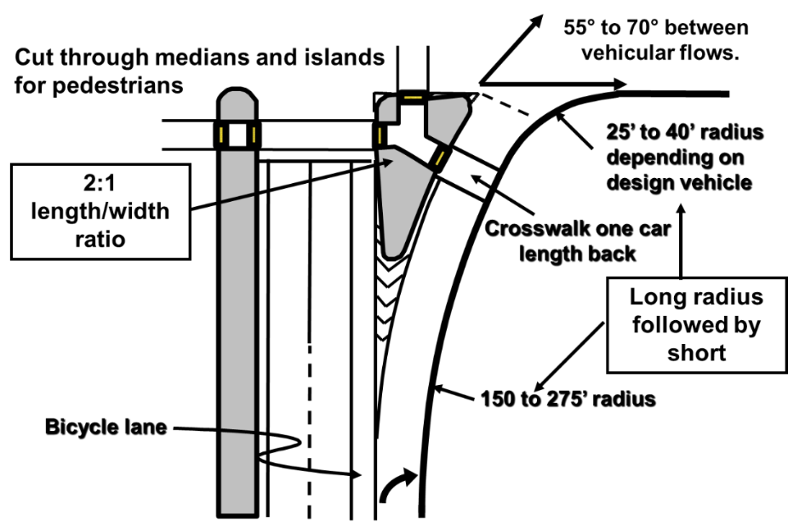
Infrastructure: Pedestrian Design Best Practices
Design/retrofit major intersections with pedestrian design best practices in mind.
Identify candidate intersections and prioritize retrofit projects

Slide 26
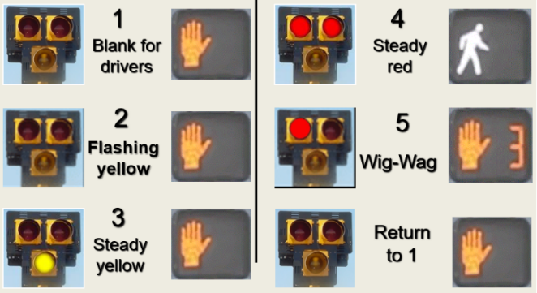
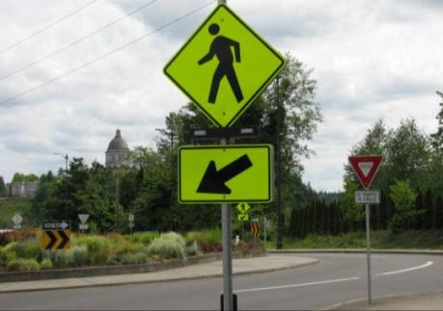
Infrastructure: Pedestrian Mid-Block Crossing
Provide raised medians or refuge islands along roadways with painted medians to help calm traffic and make it safer to cross the street.
Consider providing mid-block crossings with appropriate supplemental devices where needed.

Slide 27
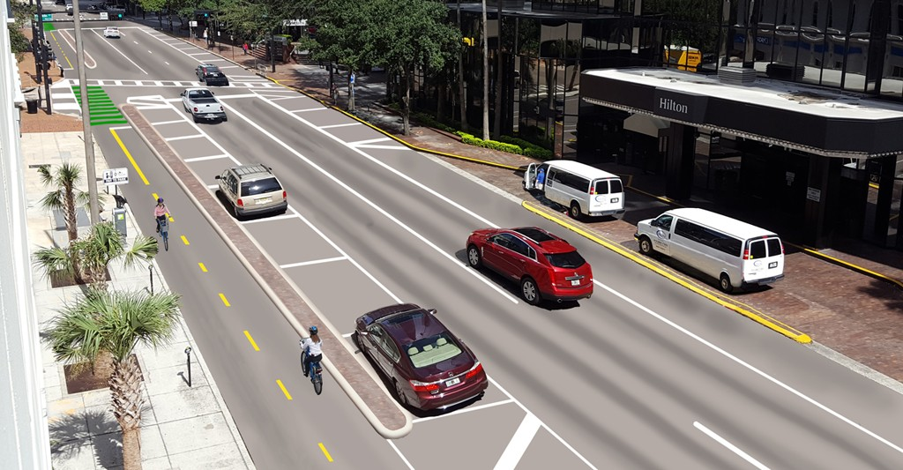
Infrastructure: Low-Stress Bike Facilities
Provide separated bike facilities along higher speed (40+ mph) major roadways
Consider the Level of Traffic Stress criteria as a performance measure for bicycle facilities (in lieu of FDOT BLOS)

Slide 28
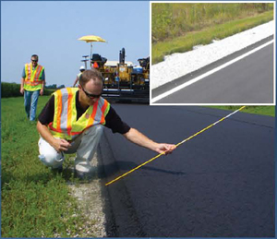
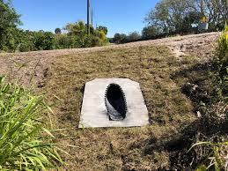
Infrastructure: Low-Stress Bike Facilities
Apply systemic improvements to rural highways including
Pavement edge treatments
Curve warning, delineation
Isolated intersection warning
Clear zone management

Slide 29
Infrastructure: Other
Continue access management approaches in suburban areas but consider new signals in urban areas.
Maintain safety focus on right turn lanes and be cautious of using right turn lanes in urban areas primarily to add capacity
Apply signalization strategies that consolidate traffic platoons and help to manage speeds
Adopt/Adapt FDOT’s intersection lighting standard to Collier County major roadways.

Slide 30
Non-Infrastructure Strategies
Non-Infrastructure Strategies | Intersection | Lane Departure | Non-Motorized | Rear End/ Sideswipe
Traffic Enforcement
Targeted Speed Enforcement | • | • | • | •
Red Light Running Enforcement | • |  | •
Automated Enforcement | • |  |  | ?
Pedestrian Safety Enforcement |  |  | •
Bike Light and Retroreflective Material Give-Away |  |  | •
Young Driver Education | • | • | • | •
WalkWise/BikeSmart or Similar Campaign |  |  | •
Continuing Education | • | • | • | •
Safety Issue Reporting | • | • | • | •
Vision Zero Policy | • | • | • | •
? = Possible Contraindication

Slide 31
Non-Infrastructure: Law Enforcement
Align law enforcement with emphasis areas focusing on speed management and intersection crashes.
Consider applying for FDOT High Visibility Enforcement Grants as a way to educate pedestrians and cyclists and check driver yielding behavior.
Consider revisiting automated enforcement as a way to free-up human enforcement resources.

Slide 32
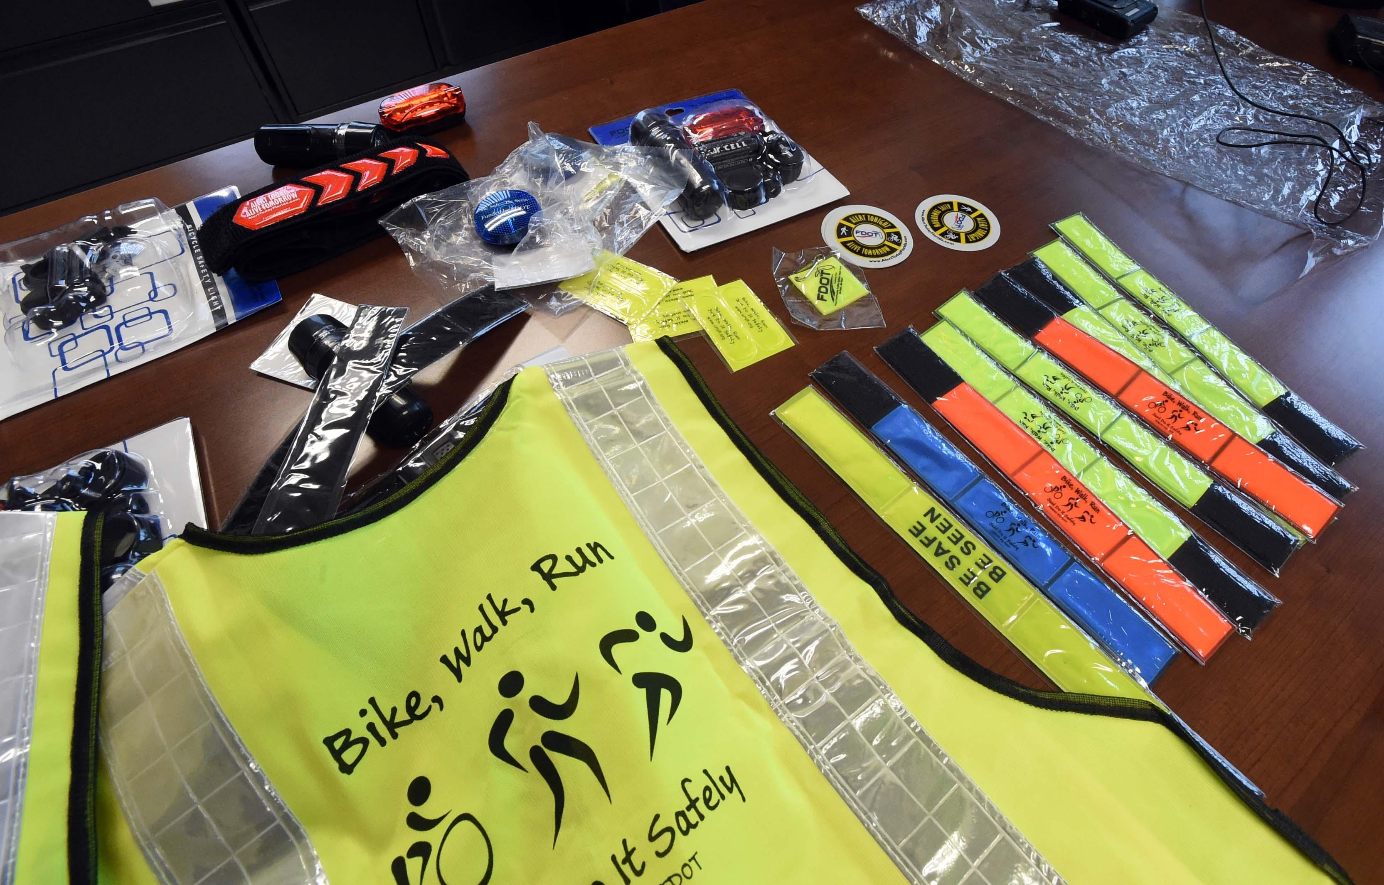
Non-Infrastructure: Give-Aways
Provide retroreflective materials and bike light kits

Slide 33
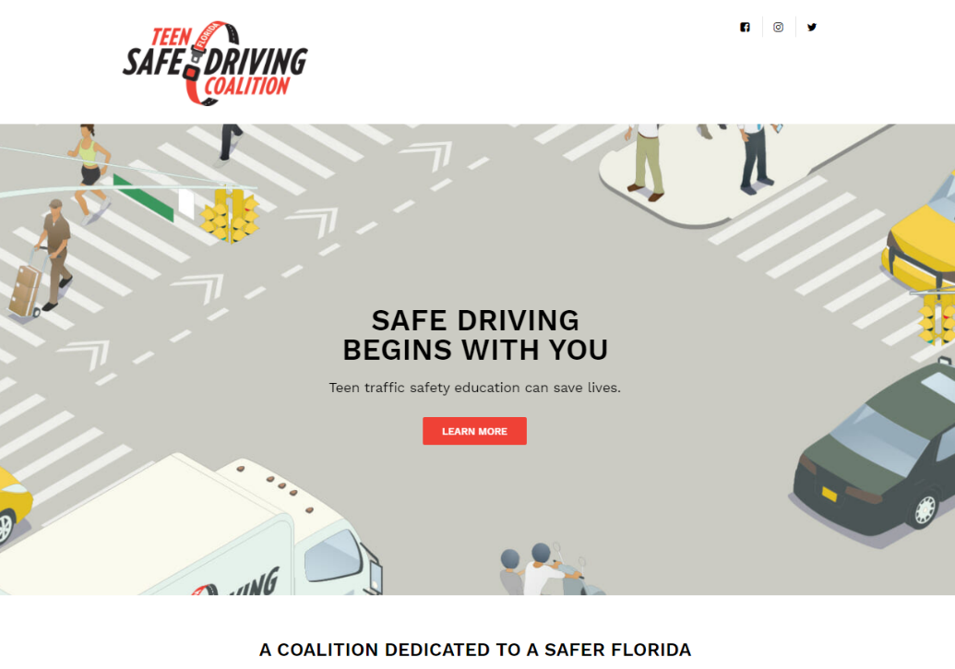
Non-Infrastructure: Teen Safe Driving
Engage with Florida Teen Safe Driving Coalition to identify and intitiate programs to reduce young driver crashes in Collier County.

Slide 34
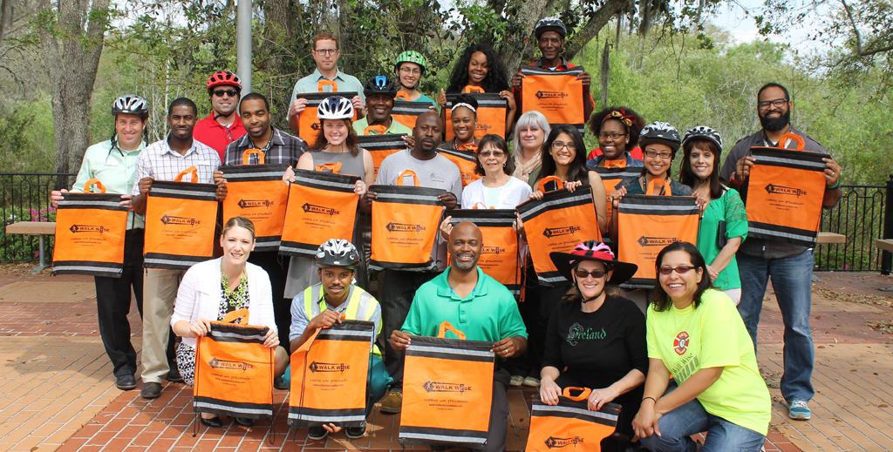
Non-Infrastructure: Adult Education
Consider implementing an adult education seminar program similar to the “WalkWise” program in the Tampa Bay area.

Slide 35
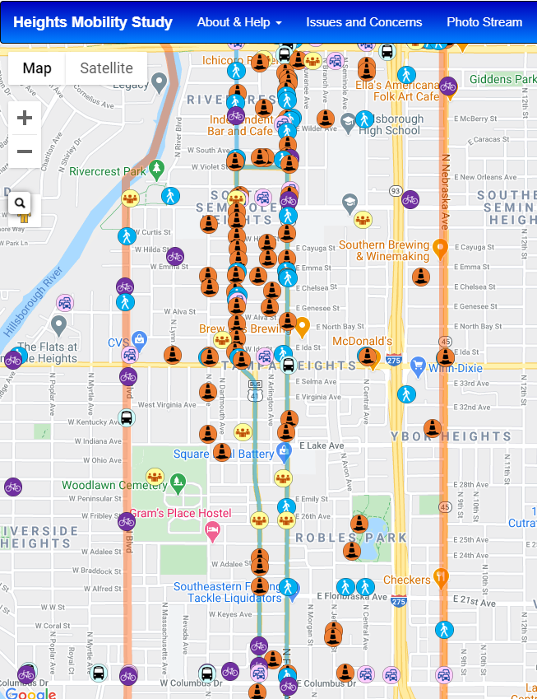
Non-Infrastructure: Safety Concern Database
Consider implementing an online system to allow safety partners (or the general public) to post non-emergency safety concerns.

Slide 36
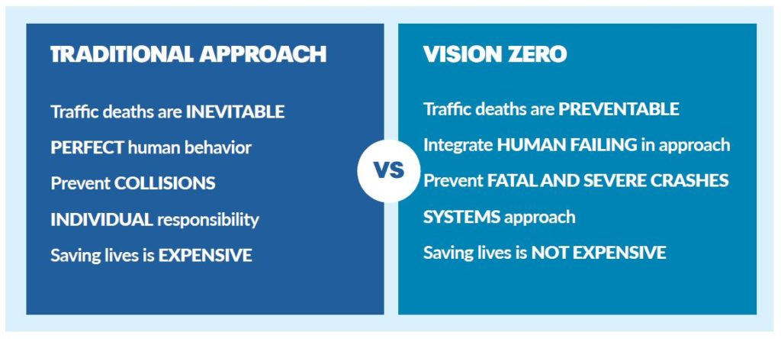
Non-Infrastructure: Vision Zero
Begin identifying local champions to implement a Vision Zero policy

Slide 37
Next Steps
Incorporate Committee Feedback
Finalize Report and Implementation Plan
Present to the MPO Board

Slide 38
Contact:
Demian Miller, AICP Anne McLaughlin
Principal Executive Director
Tindale Oliver Collier MPO
813-224-8862 239-252-5884
dmiller@tindaleoliver.com anne.mclaughlin@colliercountyfl.gov

Slide 39
Other Crash Data Stats

Slide 40
Countywide Crash Data Analysis
Crash Distribution by Major Roadway Number of Lanes:
2-lane major roadways have proportionately more severe crashes per vehicle mile travelled than multi-lane roads.
This could indicate rural highway safety issues
All Crashes
Severe Crashes
Vehicle Miles Travelled

Slide 41
Countywide Crash Data Analysis
Major Roadway Crashes* by Sub-Area:
The Western (urban) part of the county accounts for 72% of all crashes and 57% of severe crashes—roughly proportional to vehicle miles of travel.
The eastern (rural ) part of the county has fewer crashes overall, but a greater proportion of severe crashes.
All Crashes
Severe Crashes
Vehicle Miles Travelled

Slide 42
Countywide Crash Data Analysis
Lighting Condition
78% of all crashes occur during daylight hours.
Only 58% of severe crashes occur during daylight.
All Crashes
Severe Crashes

Slide 43
Countywide Crash Data Analysis
Non-Motorized Crashes by Lighting Condition:
Non-motorized crashes are more likely to occur outside of daylight hours.
This is especially true of severe non-motorized crashes.
Severe
Non-Motorized
All
Non-Motorized
All Crashes

Slide 44
PUBLIC SURVEY RESULTS

Slide 45
Live/Work & Age
Please describe yourself by checking all that apply
What is your age?

Slide 46
How often do you drive a motor vehicle (Choose one)?
How much time do you typically spend traveling each day (Choose one)?

Slide 47
How do you usually travel from place to place? (Rank from 1-6 with 1 being the most frequently used mode of transportation and 6 is the least used)
What is your usual destination when using your #1 ranked mode of transportation (Rank from 1-5 with 1 being where you travel most often and 5 being where you travel least often)?

Slide 48
Driver Behavior and Needs
What is your level of support for the following safety improvements? (Rank each from 1 to 5, with 1 being the most support and 5 being the least support)
Of the items below, which are your top three safety concerns about traveling in Collier County (Choose three)

Slide 49
Bicycle/Pedestrian Demand
How often do you walk and/or ride a bicycle? (choose one)
How often do you walk? (choose one)

Slide 50
Walking/Biking Comfort Level
In general, I feel safe and comfortable while riding a bicycle in Collier County. (Choose one)
In general, I feel safe and comfortable while walking in Collier County. (Choose one)

Slide 51
Walking/Biking Behavior
In general, Collier County pedestrians and bicyclists do a good job following the rules of the road. (Choose one)
In general, Collier County drivers are courteous about sharing the road with pedestrians and bicyclists (Choose one)

Slide 52
Biking Needs
What could be done to make bicycling safer in Collier County. (Choose three)

